Slide 1
Notes:
Brenda, create

Slide 2
Injections are the most common healthcare procedure!
16 billion injections are given worldwide every year
90% are in curative care
5% are for immunizations

Slide 3
Why is safety so important?
To prevent infection of the patient and health care providers
Prevent spread of infections
HIV
Hepatitis B and C
Hemorrhagic fevers (like ebola)
Malaria
Prevent spread of bacterial infections at the injection site
This can cause an abscess at the injection site

Slide 4
Common but unsafe: Reusing injection equipment
Re-use of injection equipment is NOT safe
Reuse of syringes and needles for more than one patient
Reinserting needles into multidose vials and then using the same vial for another patient
Informal cleaning of needles and reusing is dangerous
In 2000, WHO estimated that 40% of the 16 billion injections were given with re-used injection equipment, leading to
21 million new HBV cases (32% of all new cases),
2 million new HCV cases (40% of all new cases) and
Around 260 000 HIV cases (5% of all new HIV cases)

Slide 5
Accidental needle stick injuries in healthcare workers
Occur while giving an injection or after the injection, including handling infected sharps before and after disposal
Recapping contaminated needles increases the risk
In 2003, WHO published the burden of diseases from NSIs in HCWs which showed that there were 3 million accidental needle-stick injuries leading to:
37% of all new HBV cases in HCWs
39% of new HCV cases and
Around 5.5% of new HIV cases

Slide 6
Overuse of injections increases injury risk
Sometimes patients (and health care providers) believe that injections are more powerful than oral medications, but often this is not true.
Injectable vitamins are rarely necessary
Antibiotics are the most frequently overused injectable medications
Viral infections are not cured by antibiotics
Most antibiotics work well orally unless a patient is too sick to swallow pills or is having surgery
Overuse of antibiotics also leads to drug resistance, an increasingly dangerous problem!

Slide 7
Unsafe sharps waste management puts everyone at risk
Healthcare workers, sanitation workers and the community is at risk if needles are not disposed of correctly
Hospital laundry should not contain needles
Safety boxes should be available throughout the hospital
Needles should be completely incinerated
Needles should not be disposed of in waste pits (dumps)

Slide 8
So how can we reduce risk? Single use needles and angiocatheters (IV catheters)
Needles that are automatically covered after use protect health care workers, the laundry, and the community
Needles that cannot be used more than once prevent spread of infections

Slide 9
The WHO recommends all countries should transition to use of safety needles by 2020
If we do nothing, we will keep spreading infection
Re-use prevention and sharps injury protection can save lives
Out of every 1000 health care workers in settings where sharps injury protection devices are introduced, 9 fewer are likely to suffer a needle-stick injury in a one year period

Slide 10
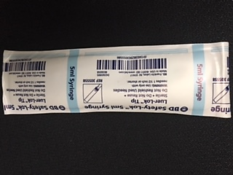
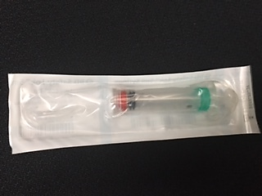
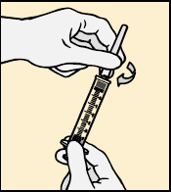
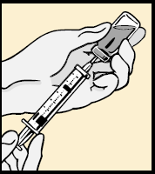
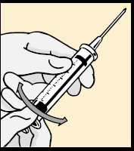
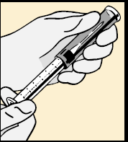
BD Safety-Lock Syringe
 | 1. Preparation To assemble, hold needle and syringe by flanges (wings) and twist needle until firmly seated
 | 2. Aspiration During aspiration, press index finger against flanges to prevent sleeve movement
 | 3. After injection After injection, grasp sleeve firmly and twist flanges to loosen the sleeve
 | 4. Retraction Fully retract needle into sleeve until it locks in the protected position When the green band (Safe Lock Indicator) fully covers the red band and an audible click is heard, the sleeve is locked into position

Slide 11
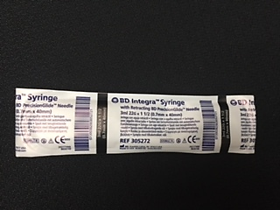
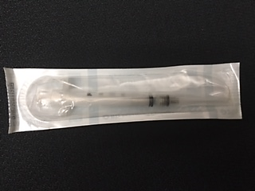
BD Integra Syringe
 | 1. Attachment Attach the ‘BD Integra’ needle onto the ‘BD Integra’ syringe with a push and a clockwise twist. If pre-attached, tighten the needle onto the syringe prior to use. Pull the shield straight off the needle.
 | 2. Aspiration Draw up medication in accordance with your institution’s protocol.
 | 3. Injection Administer medication in accordance with your institution’s protocol.
 | 4. Activation Push plunger rod to activate the safety mechanism. Depress until you sense two “clicks.” Activation can occur before or after needle is withdrawn from the patient.

Slide 12
BD Integra Syringe (cont.)
 | 5. Needle retraction The needle will disappear into the syringe and the plunger will be recessed into the barrel when activation is complete. Discard immediately into an approved sharps collector after single use.
 | Remember • If activation is performed before needle is withdrawn from patient, do not advance needle while depressing plunger rod. • If activation is after needle is withdrawn from patient, minimal performed splatter may occur. When activating the device outside of the patient, hold the device downward at arm’s length and activate while pointing away from self and others. Keep device within sight at all times to avoid accidental needle stick injury. • Do not use this product to draw blood or for venipuncture. • BD Integra™ needle and syringe do not have a standard luer connection. Conventional luer lock needles cannot be used with the BD Integra™ syringe. • When delivering highly viscous medications, use a 22G or 21G BD Integra™ retracting needle, and inject at a controlled rate. • Follow your institution’s protocol for aseptic technique and skin preparation. • Follow your institution’s policy for safe disposal of all medical waste.

Slide 13
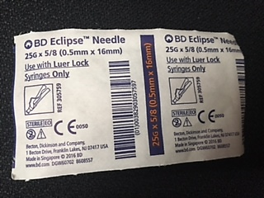
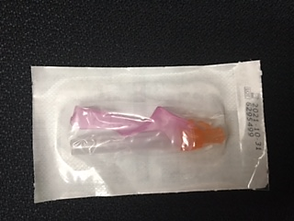
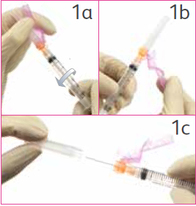
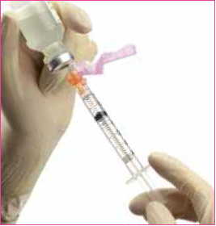
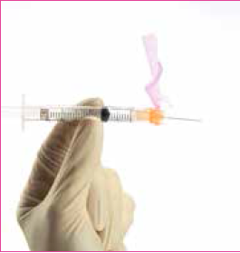
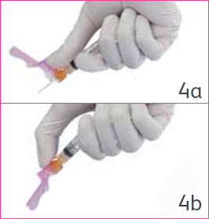
BD Eclipse Needle
 | 1. Attachment 1a. Attach the ‘BD Eclipse’ needle to any standard luer lock hypodermic syringe by twisting until firmly seated. 1b. Pull back the safety cover toward the syringe and away from the needle. 1c. Grasp the syringe with one hand and with the other pull the clear needle shield straight off.
 | 2. Aspiration Draw up medication in accordance with your institution’s protocol. NOTE: If changing needles, activate safety cover prior to removing the needle from the syringe.
 | 3. Injection Administer medication in accordance with your institution’s protocol. For user convenience, the needle’s “bevel up” position is oriented to the safety cover.
 | 4. Activation After injection, immediately activate safety cover as follows: 4a. Using the hand holding the syringe, center thumb or forefinger on the finger pad area of the safety cover. 4b. Push the cover forward over the needle until you hear or feel it lock. Use one-handed technique and activate away from self and others. Visually confirm that the needle tip is covered. After activation or if unable to activate, immediately discard into an approved sharps collector after single use.

Slide 14
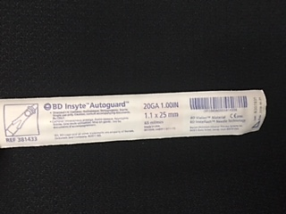
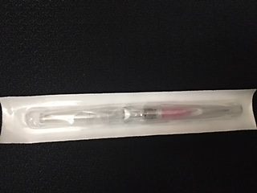
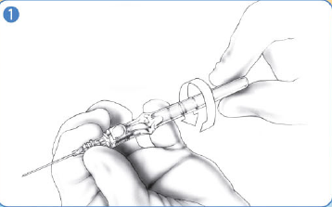
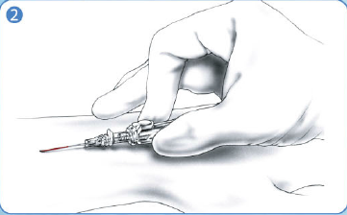
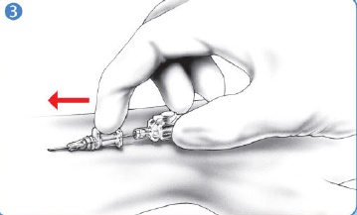
BD Insyte Autoguard
 | 1. Preparation Make sure all items are accessible throughout the procedure Prior to venipuncture hold catheter hub and rotate barrel 360 degrees Make sure catheter is seated back in the notch
 | 2. Venipuncture Approach vein slowly at a low angle Observe early flashback along the catheter (20, 22, 24 gauge only) In larger gauge sizes observe flash behind white button
 | 3. Advancement Upon flashback visualization, lower catheter almost parallel to the skin Advance entire unit slightly before threading catheter Thread catheter into vein while maintaining skin traction

Slide 15
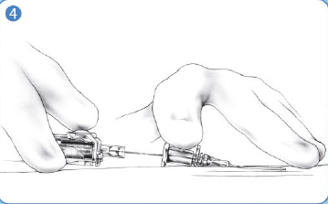
BD Insyte Autoguard (cont.)
 | 4. Needle removal Before pressing the button Release tourniquet Apply digital pressure beyond the catheter tip Gently stabilize catheter hub Press the white button
 | 5. Securement Secure catheter and apply sterile dressing
 | Caution Reminders: Do not withdraw needle from catheter hub before pressing the white button Needle should be retracted prior to disposal in a puncture-resistant, leak-proof sharps container Never reinsert needle into the catheter as this could shear the catheter

Slide 16
Thank you! Questions?

